Slide 1
PRINCIPLE study
Platform Randomised trial of INterventions against COVID-19 In older peoPLE
Chief Investigator: Professor Chris Butler
Sponsor: University of Oxford
Funded by UKRI/NIHR

Slide 2
Aim:
To be the national Primary Care platform trial for UK COVID-19, assessing the effectiveness of trial treatments in reducing the need for hospital admission or death for patients with suspected COVID-19 infection aged ≥50 years with comorbidity, and aged ≥65 with or without comorbidity, and during time of prevalent COVID-19 infections in the context of current care delivery

Slide 3
We are looking at…
Best usual primary care
VS
Existing drugs that may be active against COVID-19

Slide 4
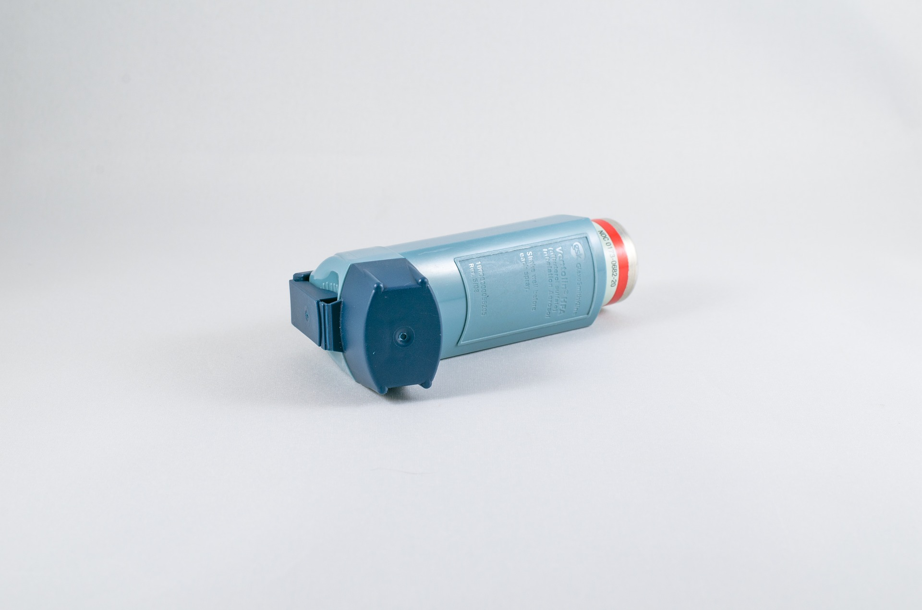
We are looking for
Patients aged ≥65 with or without comorbidity
OR
Patients aged ≥50-64 years with any of the following listed comorbidities:
Known weakened immune system due to a serious illness or medication (e.g. chemotherapy);
Known heart disease and/ or hypertension
Known asthma or lung disease
Known diabetes not treated with insulin
Known mild hepatic impairment
Known stroke or neurological problem

Slide 5
WITH
New Continuous Cough
A high temperature (hot to touch)
And/Or
within 14 days

Slide 6
Ambulatory Service models
There are 3 models for running this study within Ambulatory services. Which route is chosen depends on:
The level of notes access the Ambulatory service has
The resource the Ambulatory service has (both staff and call time)
Depending on the above, Ambulatory services can choose from the following routes:
LAS Route – If the Ambulatory staff have full access to GP notes, they will be able to complete the eligibility themselves (assuming enough staff and call time).
NWAS Route - If the Ambulatory staff do not have full access to the notes, a member of staff can complete the screening and contact details and will call the GP to complete the eligibility section. If 111 services staff don’t have capacity to make the call, the CRN may offer support to ensure screening and eligibility checks are set up.
Low Impact Route – the Ambulatory service would complete the screening and contact details questions with the patient. Members of Oxford CTU staff complete the eligibility section with the GP. This route reduces the time per call and the level of investment required from Ambulatory services.

Slide 7
Principle Clinical Trials – LAS Model Flow
National CRS
Local CRS
Option A – starting point. Call within consultation
COVID Category 2 patients ‘Symptomatic patients, further assessment required’.
Disposition= Speak to Clinician
Patient enters queue for call back by clinician
COVID Call queue
Script as part of CRF for clinician during call back.
Speak to Clinician
1
Clinician, following consultation with patient, enquires whether patient would like to be part of the trial.
2
Clinician in goes through eligibility criteria with patient following consent. Patient either stays on phone or is called back
Patient receives email/text, goes through link on website, reads consent form, signs up for trial
4
If patient meets eligibility criteria for trial – email/text sent to patient.
Central research team validate patient meets eligibility criteria by receiving entry (point 3) via shared online portal
3
5
Patient randomised as long as not hospitaled by CAS clinician
Central research team write to patients GP following patient consent to inform them of patient participation on trial
Escalate to 999 ambulance (Would not be in trial)
Proactive action within primary care
Self isolation and worsening advice

Slide 8
Principle Clinical Trials – NWAS Model Flow
National CRS
Local CRS
COVID Category 2 patients ‘Symptomatic patients, further assessment required’.
Disposition= Speak to Clinician
Patient enters queue for call back by clinician
Clinical Call queue
Script to be developed for research nurse / paramedic
To outline the following:
This is not their clinical call back
Verbal permission to contact GP to check eligibility and store patient details in shared database with trial team for 7 days
Will receive email with website link to inform the patient about the trial and sign up
If the patient does not wish to participate, no details will be retained after 7 days.
Research nurse / paramedic identifies that patient may be eligible Disposition (>P3 only).
1
Communication between research team and CAS clinician – in case patient raises the subject of trial with clinician
4
Research nurse / paramedic in use script to contact patient and obtain consent for patient GP to be contacted for eligibility assessment.
2
5
Patient receives email, goes through link on website, reads consent form, signs up for trial
Research nurse/Paramedic ends call with patient and calls GP to complete eligibility assessment. Patient sent email following successful completion of eligibility criteria.
Research clinician writes in patient notes.
3
Central research team write to patients GP following patient consent to inform them of patient participation on trial
Call back by Clinician
Escalate to 999 ambulance (Would not be in trial)
Proactive action within primary care
Self isolation and worsening advice

Slide 9
Principle Clinical Trials – Low burden model
National CRS
Local CRS
COVID Category 2 patients ‘Symptomatic patients, further assessment required’.
Disposition= Speak to Clinician
Patient enters queue for call back by clinician
4
Clinical Call queue
Script to be developed for research nurse / paramedic in
To outline the following:
This is not their clinical call back
Verbal permission to contact GP to check eligibility and store patient details in shared database with trial team for 7 days
Will receive email with website link to inform the patient about the trial and sign up
If the patient does not wish to participate, no details will be retained after 7 days.
Eligibility checked with patients GP, by CTU staff.
1
Clinician in identifies that patient may be eligible. Disposition (>P3 only).
5
Clinician in uses script to contact patient and obtain consent for patient GP to be contacted for eligibility assessment.
Patient receives email, goes through link on website, reads consent form, signs up for trial
2
Research nurse/Paramedic completes screening questionnaire and ends call with patient
6
Central research team write to patients GP following patient consent to inform them of patient participation on trial
3
Call back by Clinician
Escalate to 999 ambulance (Would not be in trial)
Proactive action within primary care
Self isolation and worsening advice

Slide 10
Requirements for study
LAS Route
Access to full medical notes (including blood results)
Enough resource to manage the calls “In house”, both time and staffing
NWAS Route
Either internal staff to do research calls or staffing support from your local CRN
If using CRN staff, confirm if staff will need honorary contracts
Low Burden Route
5-7mins additional time on call to run through basic screening questions with potential participant
Low burden route could be used by paramedics for patients not being sent to hospital
For all routes:
Gain research payments per patient
Gain accruals as a site

Slide 11
Setup information
To set sites up we will need the following:
A signed contract (we are using the model Non-Commercial Agreement – mNCA)
A delegation letter signed by PI
A completed staff training checklist
CV and GCP certificates just from PI
We will organise training for staff who need it on our database, Sentry:
https://sentinel.phc.ox.ac.uk/sentry/principle111/demo/survey/closed_login/screening

Slide 12
Thanks for your time!
Questions?
Further question after the meeting can be sent to:
Email: principle@phc.ox.ac.uk

