Slide 1

PRINCIPLE
Platform Randomised trial of INterventions against COVID-19 In older peoPLE
Chief Investigator: Professor Chris Butler
Sponsor: University of Oxford
Funded by UKRI/NIHR

Slide 2

Aim:
To be the national Primary Care platform trial for UK COVID-19, assessing the effectiveness of trial treatments in reducing the need for hospital admission or death for patients with suspected COVID-19 infection aged ≥50 years with comorbidity, and aged ≥65 with or without comorbidity, and during time of prevalent COVID-19 infections in the context of current care delivery

Slide 3
What is a Platform Trial?
A platform trial allows for multiple treatments to enter or exit the trial over the course of the study, providing researchers the ability to adapt to results that are observed throughout a study.
This flexibility allows teams to drop treatments for futility, to declare one or more treatments superior, or even to add new treatments for assessment during a trial – allowing clinicians to better meet the unique needs of patient populations within a study.

Slide 4

We are looking at…
Best usual primary care
VS
Existing drugs that may be active against COVID-19

Slide 5

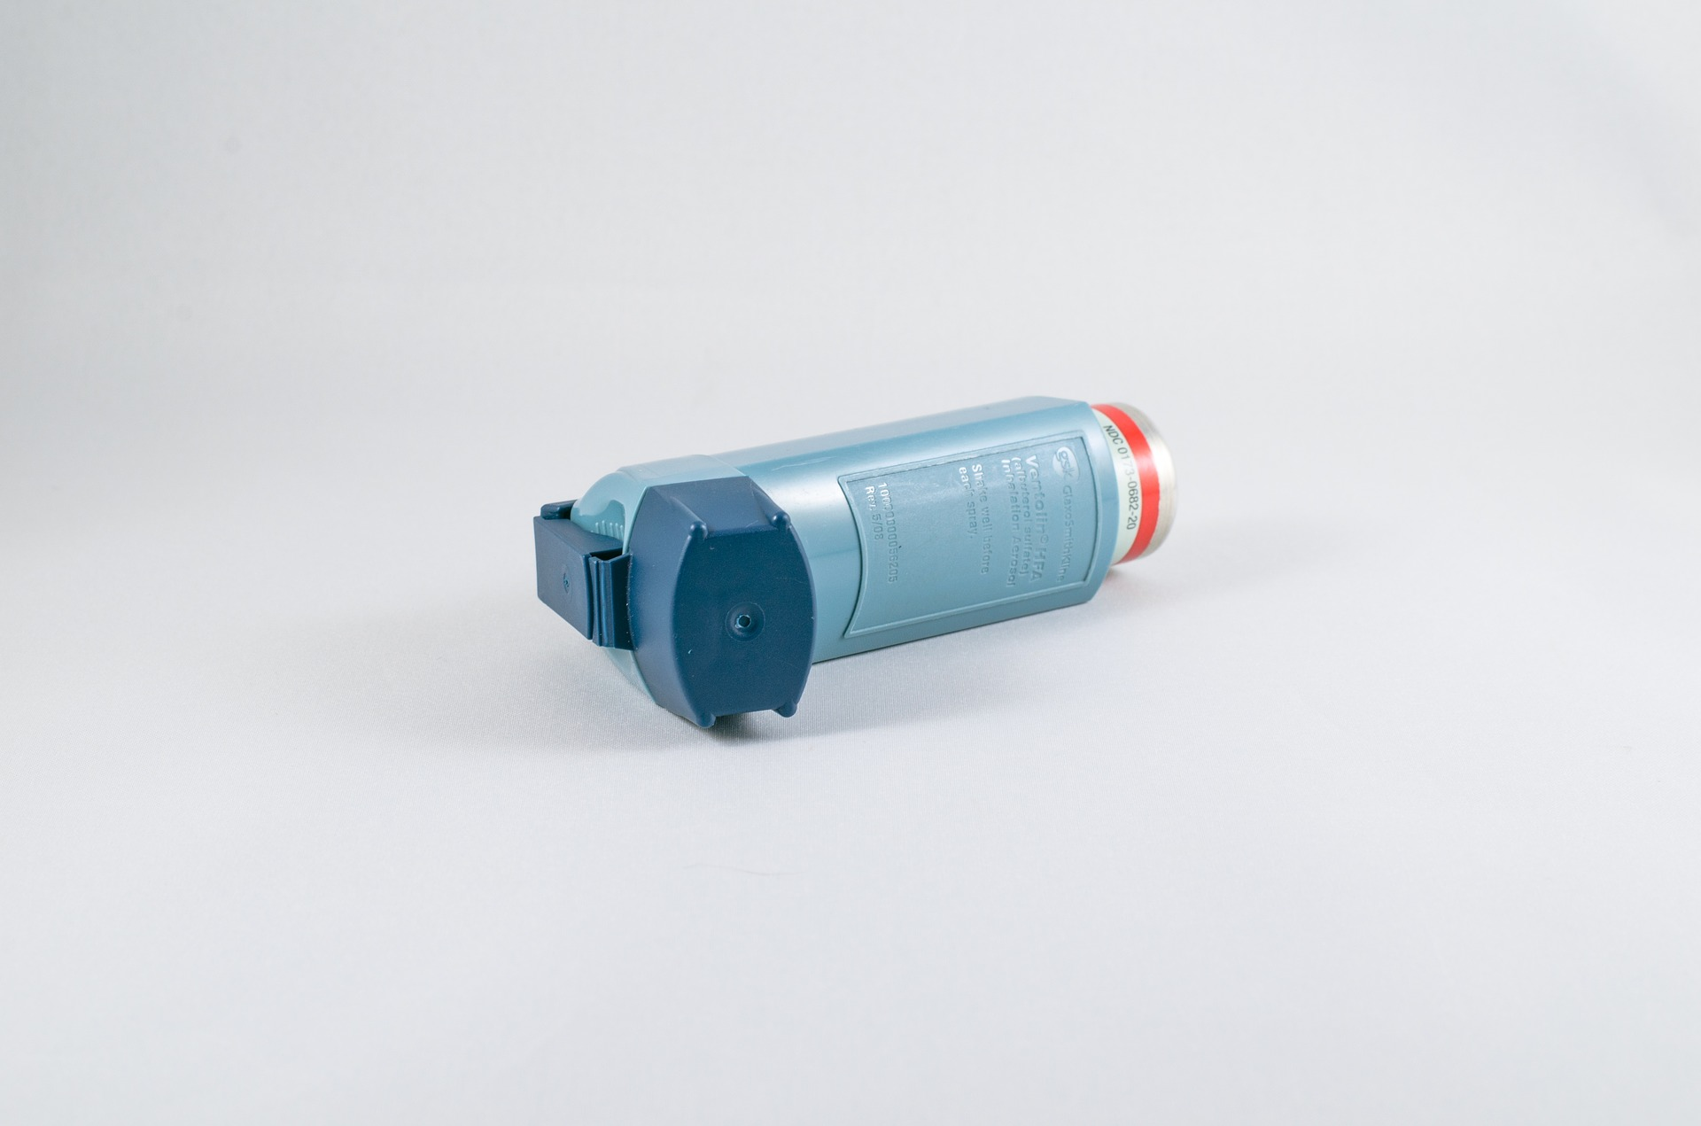
We are looking for
We are looking for: Patients aged ≥50-64 years with any of the following listed comorbidities:
Known weakened immune system due to a serious illness or medication (e.g. chemotherapy);
Known heart disease and/ or hypertension
Known asthma or lung disease
Known diabetes
Known mild hepatic impairment
Known stroke or neurological problem
OR Patients aged ≥65 with or without comorbidity

Slide 6


WITH
New Continuous Cough
A high temperature (hot to touch)
Change/loss of smell/taste
And/Or
And/Or
within 14 days of inclusion
OR
A positive COVID-19 test in the last 14 days with any symptoms

Slide 7
Principle Clinical Trials – Low burden model
Local Ambulatory Care
Central Trial Team Completes these steps
COVID Category 2 patients ‘Symptomatic patients, further assessment required’.
Script embedded in CRF outlines the following:
Obtain verbal permission to store patient details in shared database with Oxford trial team for 7 days
Patient receives email with website link to inform the patient about the trial and sign up. Trial team will call if no internet access
If the patient does not wish to participate, no details will be retained after 7 days.
Estimated additional call time 3-5 minutes.
Clinical Call
Eligibility checked with patients GP, by CTU staff.
4
1
After clinical assessment, Clinical Team Member identifies that patient may be eligible. Disposition (>P3 only).
Patient receives email/phone call, goes through link on website, reads consent form, signs up for trial
5
Clinical Team Member uses script embedded in CRF to obtain consent for contact details to be forwarded to Oxford University patient GP to be contacted for eligibility assessment.
2
Central research team write to patients GP following patient consent to inform them of patient participation on trial
6
3
Clinical Team Member completes screening questionnaire and ends call with patient

Slide 8
What will my service be doing on the study?
You will be screening potentially eligible patients to take part in the study. This information will be collected on our unique database: SENTRY. A training video on how to use SENTRY is available at: https://www.phctrials.ox.ac.uk/principle-trial/ambulatory-care-111-hubs-and-health-trusts
A script on what you need to say is provided within SENTRY. During your call with the patient you will be collecting information including:
The patients name and contact details
What GP practice they belong to
If they consent for their information to be seen by University of Oxford researchers.
Some basic information about the patient’s medical history (this is all self reported by the patient).
A guide on full eligibility is available.

Slide 9
If you have any questions about the study, please speak to your Principle Investigator in the first instance. The trial team can be contacted via email at principle@phc.ox.ac.uk

