Slide 1

PRINCIPLE study
Platform Randomised trial of INterventions against COVID-19 In older peoPLE
Chief Investigator: Professor Chris Butler
Sponsor: University of Oxford
Funded by UKRI/NIHR

Slide 2
Care Homes will need to:
Identify potential participants by using the following methods:
Perform search of records to identify residents with a positive swab test
Identify participants with COVID-19 symptoms and ask them if they’re interested in registering for the trial.
The care home will be provided with the following information to provide to potential participants:
Patient Information Sheet, including a simplified pictorial version
Participant Recruitment Poster – to advertise the study throughout the different care homes.

Slide 3
Trial activities performed centrally by the trial team
Screening, eligibility, informed consent and follow-up can all be performed through the online trial website. If online access is not possible, the trial team will collect all of this information over the phone.
Participant packs containing: swab, participant identification card, trial booklet and medication (if randomised to the trial treatment arm) will be sent directly to the participant from the CTU.
Participants are asked to complete an online daily diary for 28 days (approx. 10 mins/day). If online access is not possible, the trial team will collect follow-up information over the phone at day 7, 14 and 28 (we can arrange a mutually convenient time to call the participant, during the first phone call).

Slide 4
Study Partner
The trial team will ask the potential participant to (if possible) include a phone number and email address for a study partner.
The study partner may provide assistance to the study participant in completing trial procedures, particularly in environments such as residential and nursing homes.
A study partner letter will be provided to outline guidelines on how study partners can support participants in the trial.

Slide 5

Aim:
To be the national Primary Care platform trial for UK COVID-19, assessing the effectiveness of trial treatments in reducing the need for hospital admission or death for patients with suspected COVID-19 infection aged ≥50 years with comorbidity, and aged ≥65 with or without comorbidity

Slide 6

We are looking at…
Best usual primary care
VS
Existing drugs that may be active against COVID-19

Slide 7

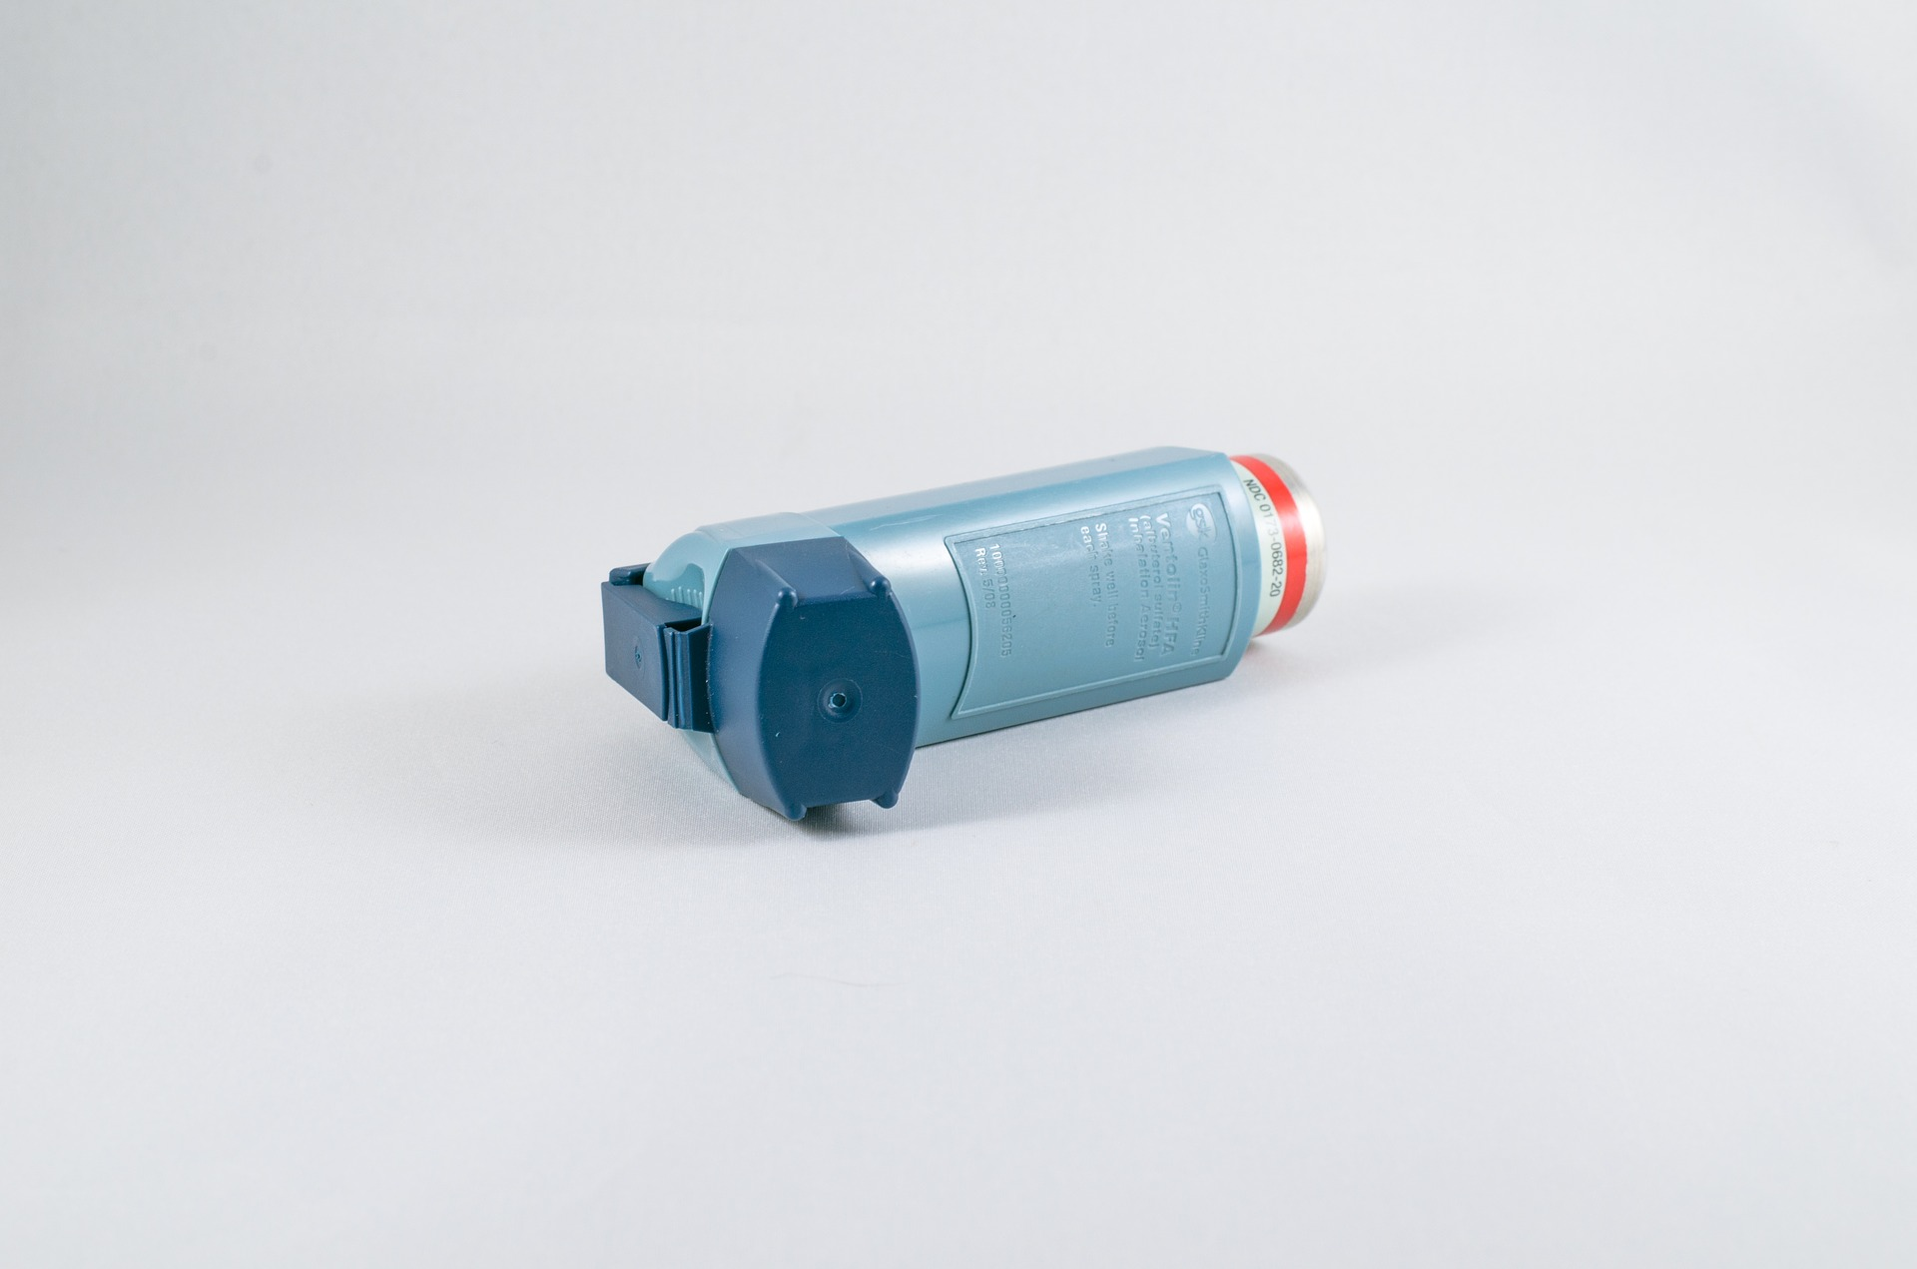
We are looking for
We are looking for: Patients aged ≥50-64 years with any of the following listed comorbidities:
Known weakened immune system due to a serious illness or medication (e.g. chemotherapy);
Known heart disease and/ or hypertension
Known asthma or lung disease
Known diabetes not treated with insulin
Known mild hepatic impairment
Known stroke or neurological problem
OR Patients aged ≥65 with or without comorbidity

Slide 8


WITH
New Continuous Cough
A high temperature (hot to touch)
Or
OR
Positive SARS-CoV-2 test in the presence of symptoms
within 14 days of inclusion

Slide 9
Most patients will be able to consent and register onto the trial remotely using an online system. The PRINCIPLE Study team will help patients do this over the phone where needed.
Clinically qualified GPs and research nurses within the trial team will confirm whether the patient is eligible to take part in the study.

Slide 10
Randomisation
Participants will be randomised to either
Usual Care
Usual Care Plus Trial Medication
OR
Randomisation result is instant once trial team have confirmed eligibility and participants will be provided with a trial ID. A letter confirming which group the participant has been randomised to
and copy of the consent form will be sent to the participant’s GP and care home.

Slide 11
The trial Medication (and swab) will be sent directly to the care home for participants randomised to the Medication Arm of the trial.
Participants in the usual care groups will receive a swab (dependent on availability).

Slide 12


USUAL CARE GROUP
GPs to provide clinical care and advice according to current practice
Participants will be advised to contact their GP if their condition worsens or they have concerns about their illness at any time during the trial.
All participants will be able to take their usual prescribed medications and medicines such as paracetamol but they should agree not to take any experimental or unlicensed drugs for their illness.
* The study team will not be responsible for the usual medical care of the participants illness

Slide 13

Public Health England will provide GP’s with the swab result when available
GP will call the participant and provide swab result

Slide 14
Communicating a negative swab result
If a participant’s swab result is negative it is important to make it clear that they should continue with the full course of trial medication (if randomised to the medication arm) and complete their trial diary.
Suggested explanation to the participant: ‘Although the swab is negative we would like you to continue taking the full course of trial medication (if applicable) and complete the trial diary to record your recovery from the illness. Although the laboratory analysis is usually accurate there can be occasions when it is not able to detect the virus from the swab. For example, a negative swab result can sometimes occur if not enough sample was taken, or if the swab was taken at a very early stage of infection with the virus.’

Slide 15

Serious Adverse Event
Reporting
IF YOU BECOME AWARE OF AN SAE PLEASE REPORT WITHIN 24 HOURS (principle@phc.ox.ac.uk)
What SAEs should I report?
An event which:
i) leads to hospitalisation or death NOT DUE to COVID-19
i) is life-threatening
ii) results in persistent or significant disability/incapacity
iii) consists of a congenital anomaly or birth defect*.
Hospitalisation or death due to COVID-19 DO NOT need to be reported as SAEs

Slide 16

Identify potential participants through running a search of positive swab results
Identify potential participants who display COVID-19 symptoms
Support participant enrolment to the trial by providing online/phone access.
The central trial team can perform all activities over the phone with the participant/study partner
Support participants with self-swabbing/ medication administration
Support participant follow-up by providing online/phone access.

Slide 17
MANY THANKS!
Please contact the team if you have any problems:
Email: principle@phc.ox.ac.uk
Phone Number: 0800 138 0880

