Slide 1

PRINCIPLE study
Platform Randomised trial of INterventions against COVID-19 In older peoPLE
Chief Investigator: Professor Chris Butler
Sponsor: University of Oxford
Funded by UKRI/NIHR

Slide 2

Aim:
To be the national Primary Care platform trial for UK COVID-19, assessing the effectiveness of trial treatments in reducing the need for hospital admission or death for patients with suspected COVID-19 infection aged ≥50 years with comorbidity, and aged ≥65 with or without comorbidity, and during time of prevalent COVID-19 infections in the context of current care delivery

Slide 3

We are looking at…
Best usual primary care
VS
Existing drugs that may be active against COVID-19

Slide 4

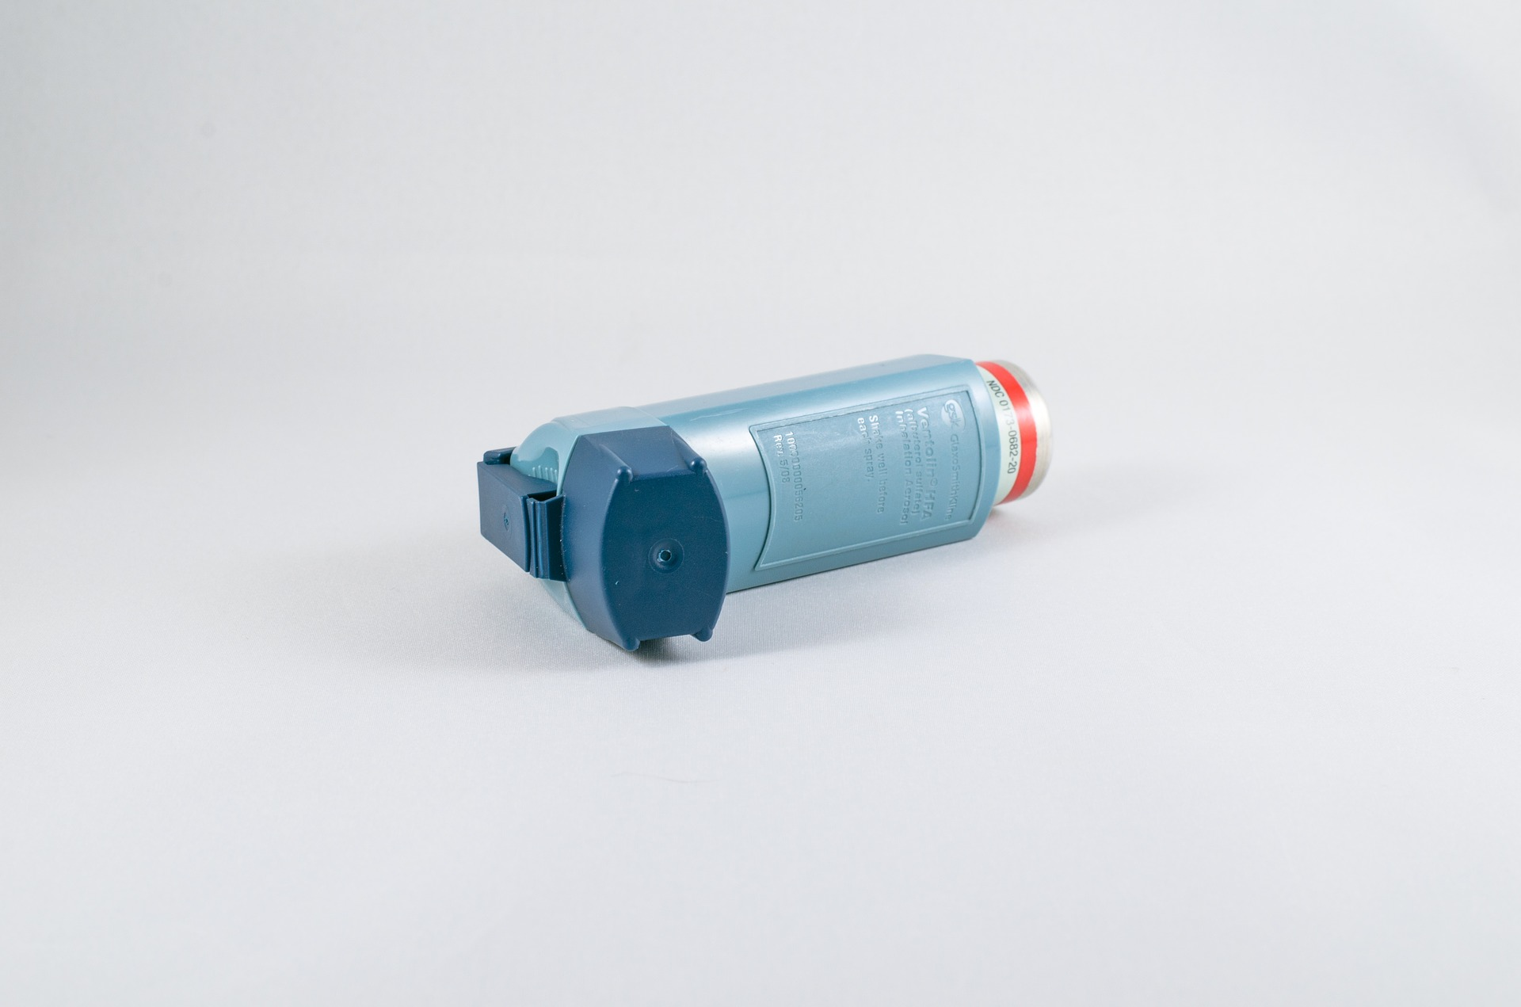
We are looking for
We are looking for: Patients aged ≥50-64 years with any of the following listed comorbidities:
Known weakened immune system due to a serious illness or medication (e.g. chemotherapy);
Known heart disease and/ or hypertension
Known asthma or lung disease
Known diabetes not treated with insulin
Known mild hepatic impairment
Known stroke or neurological problem
OR Patients aged ≥65 with or without comorbidity

Slide 5


WITH
New Continuous Cough
A high temperature (hot to touch)
And/Or
within 14 days of inclusion

Slide 6

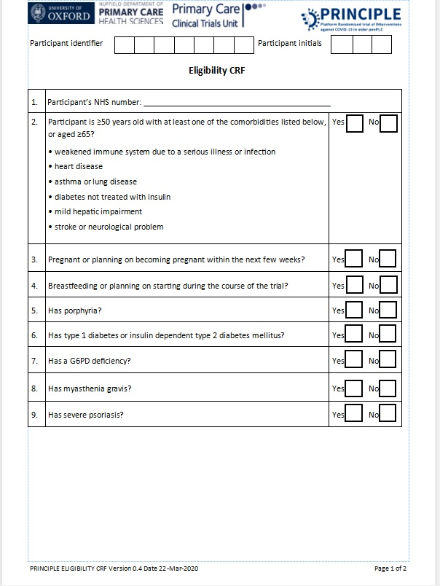


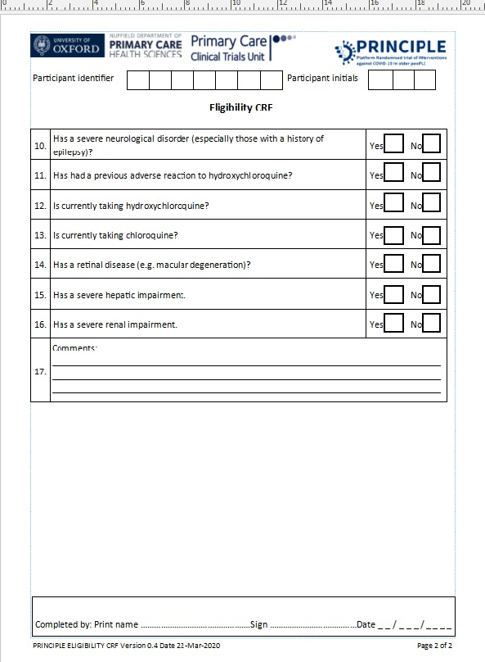
See Protocol Page 18

Slide 7
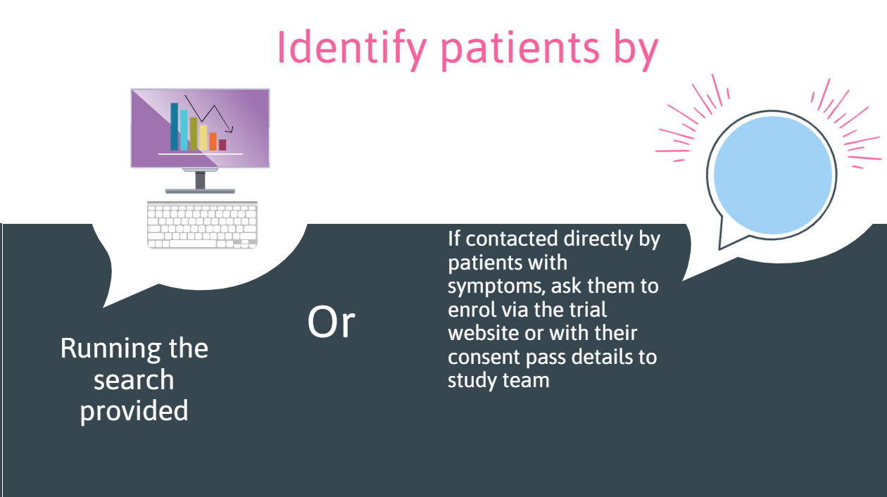

Slide 8


Slide 9
All assigned GP’s will receive an email once a patient has provided informed consent
Please follow the email link and log in to Sentry and confirm whether the patient is eligible to take part in the study.
Sentry Link: https://sentry.phc.ox.ac.uk/sentry/

Slide 10
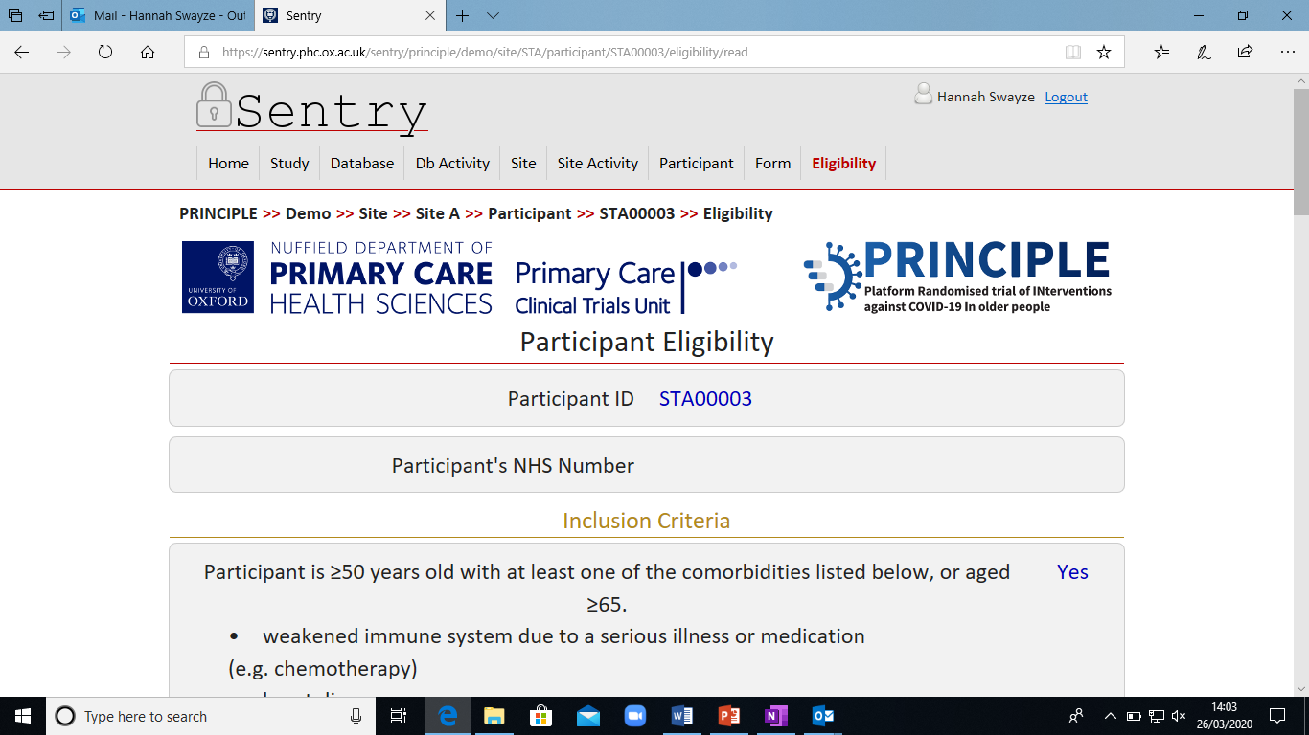
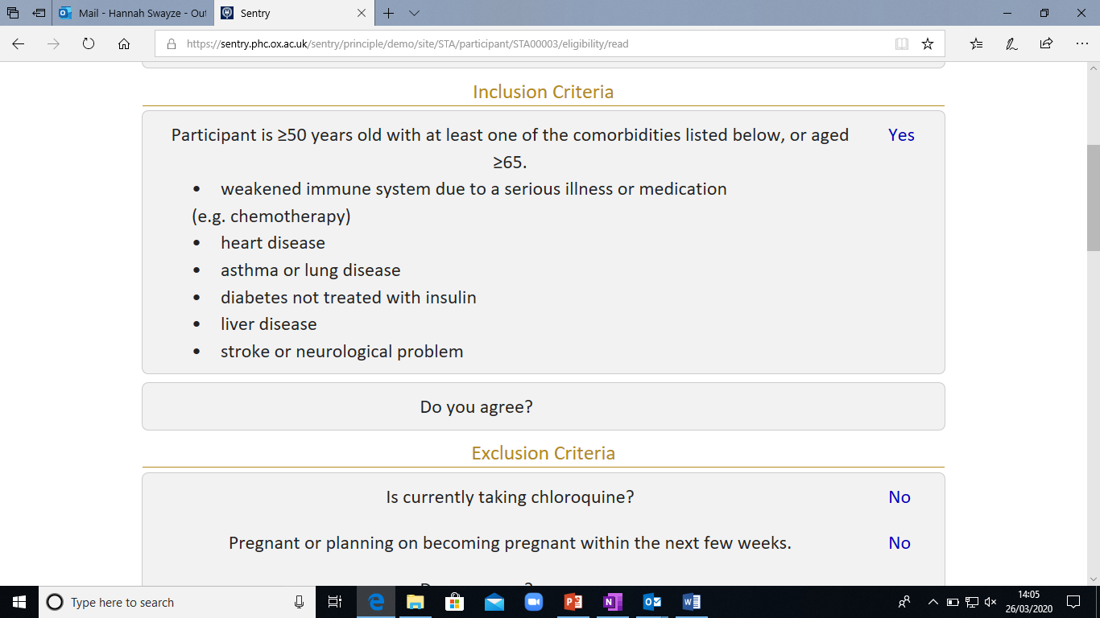
Sentry
You will be taken to the ‘Participant Eligibility’ page
You will be asked to enter the Participant’s NHS number and confirm that the Participant meets the Inclusion Criteria.

Slide 11
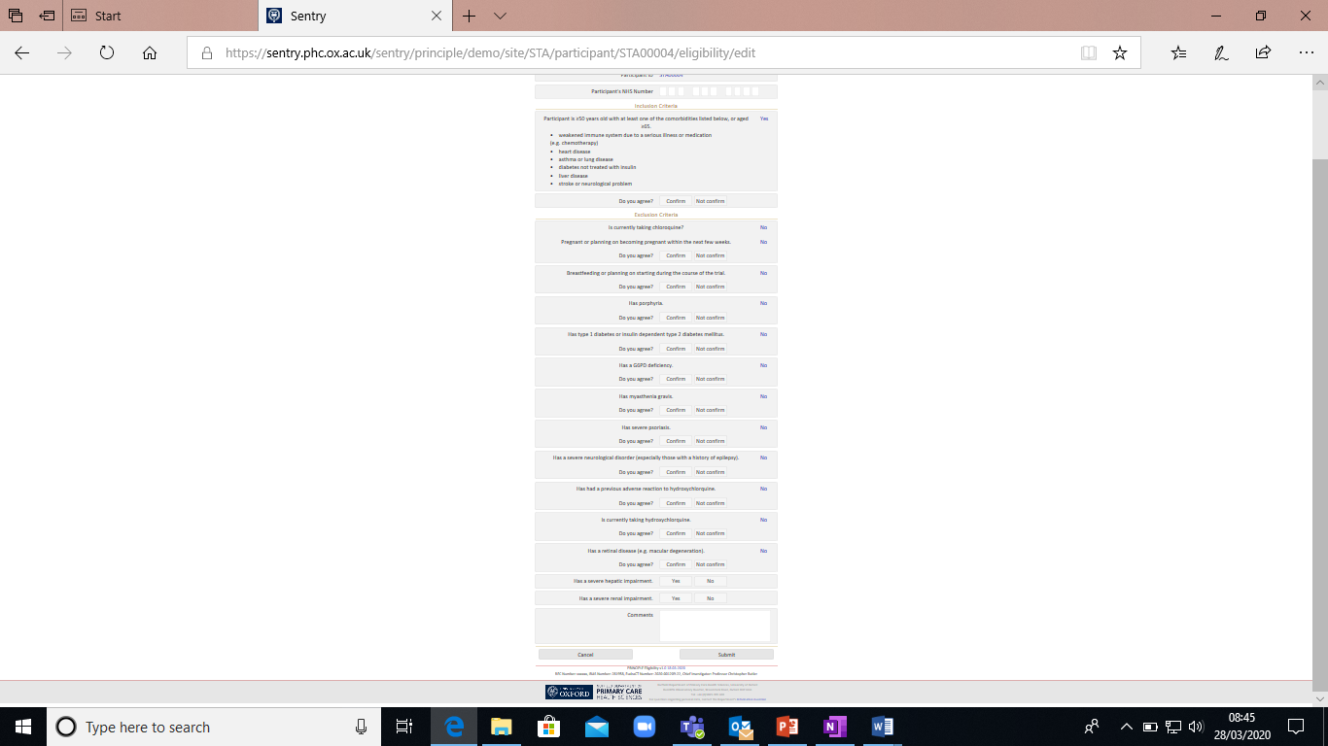
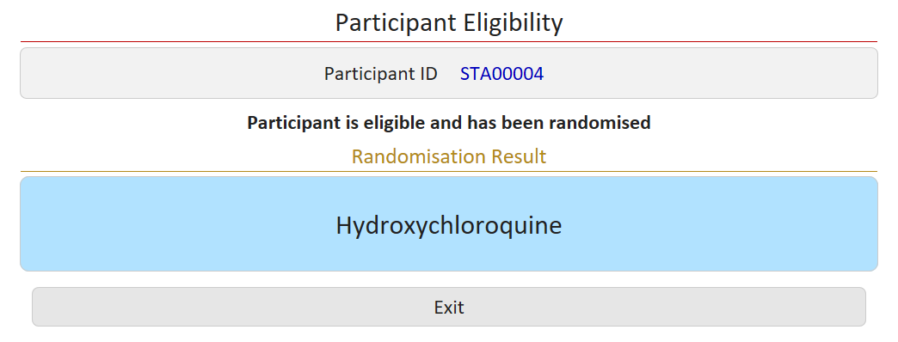
Sentry
Confirm the Participant does not meet the exclusion criteria
When you click CONFIRM the Participant will automatically be Randomised

Slide 12
Randomisation
Participants will be randomised to either
Usual Care
Usual Care Plus Trial Medication
OR
Randomisation result instant, copy automatically sent to trial team and participant, randomisation will also provide participants trial ID

Slide 13
Trial Medication must ONLY be provided to Participants randomised to the Medication Arm of the trial

Slide 14


USUAL CARE GROUP
GPs to provide clinical care and advice according to current practice
Participants will be advised to contact their GP if their condition worsens or they have concerns about their illness at any time during the trial.
All participants will be able to take their usual prescribed medications and medicines such as paracetamol but they should agree not to take any experimental or unlicensed drugs for their illness.
* The study team will not be responsible for the usual medical care of the participants illness

Slide 15


USUAL CARE PLUS TRIAL MEDICATION GROUP
Follow usual care instructions plus the following steps by a Doctor or Pharmacist
Issue FP10 prescription to ensure trial medication captured in patient record (printed scripts can then be shredded)
Take one envelope with pre-printed trial medication label attached
Add participants trial ID to label
* Please refer to WI Repackaging of IMP at GP site

Slide 16

Ensure patient instructions on taking medication inside envelope (trial team will try to provide these pre-prepared)
Add one blister pack (15 tablets) to the envelope, seal
Record participant ID and serial number of blister pack (from IMP box) on ‘PRINCIPLE Trial Drug Accountability Log’
Provide envelope to participant or their representative, GP responsible for informing participant on how they should receive medication

Slide 17

1. Unless swab already taken for this illness episode provide COVID 19 self swab pack
2. If participant randomised to medication group, provide swab with trial medication (patients will be asked to take their swab before starting medication)
OR
3. If participant randomised to usual care group either post swab to participant or request collection by participants representative, GP responsible for informing participant on how they should receive their swab

Slide 18
Please complete the PHE Microbiology Request Form to send with the Participant’s swab pack
Please make sure you have completed the following (If not set-up on your system to run automatically):
NHS no
DOB
Practice name

Slide 19

Public Health England will provide GP’s with the swab result when available
GP will call the participant and provide swab result
The trial team may call GP to follow up on swab result

Slide 20
Communicating a negative swab result
If a participants swab result is negative it is important to make it clear that they should continue with the full course of trial medication (if randomised to the medication arm) and complete their trial diary.
Suggested explanation to the participant: ‘Although the swab is negative we would like you to continue taking the full course of trial medication (if applicable) and complete the trial diary to record your recovery from the illness. Although the laboratory analysis is usually accurate there can be occasions when it is not able to detect the virus from the swab. For example, a negative swab result can sometimes occur if not enough sample was taken, or if the swab was taken at a very early stage of infection with the virus.’

Slide 21

How do I order more swabs?
Email practiceenquiries@phc.ox.ac.uk
The trial team will also track use and call GPs to ensure re-order and discuss any issues

Slide 22

How do I order more drug?
Order will initially be capped at 3 packs of 60 tablets per practice. If you would like more, please request from CTU who will update PHE.
Please use website: https://portal.immform.dh.gov.uk, clicking ‘PRINCIPLE Trial’ button to order more medication (if ordered by 11am it should arrive the next day).
The Trial team will also track use and call GP to ensure re-order, any issues call us
Once the order is placed via IMMform, drug will be delivered to practices from PHE

Slide 23
Serious Adverse Event
Reporting
IF YOU BECOME AWARE OF AN SAE PLEASE REPORT WITHIN 24 HOURS (contact details).
What SAEs should I report?
An event which:
i) leads to hospitalisation or death NOT DUE to COVID-19
i) is life-threatening
ii) results in persistent or significant disability/incapacity
iii) consists of a congenital anomaly or birth defect*.
Hospitalisation or death DO NOT need to be reported as SAEs

Slide 24


Slide 25

For participants randomised to the trial treatment arm provide medication pack (including envelope, participant instructions, trial contact card etc.)
Confirm eligibility for all participants
Randomise all eligible participants
Provide the PHE swab pack for ALL
participants
Inform participants of their swab result

Slide 26

Symptom
Diaries
Participants will start filling in their 28 day online diary from the day after Randomisation

Slide 27
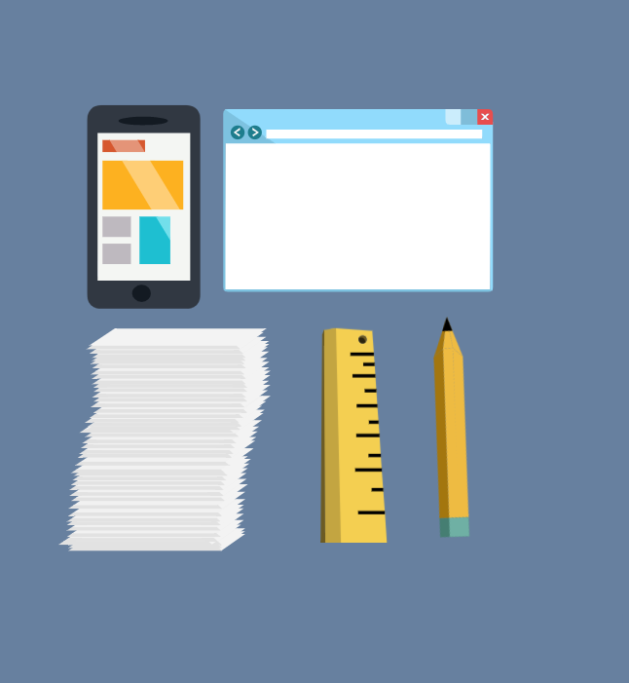
Participants will receive a telephone call on day 7, 14 and 28 if they’re not completing their daily diary online

Slide 28


Slide 29
Please contact the team if you have any problems:
Email: principle@phc.ox.ac.uk
Phone Number: 0800 138 0880

